Slide 1
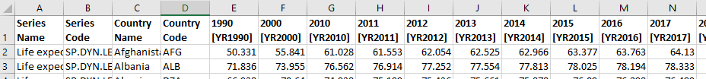
Overview
Data sets from data.world
CSV format, saved in Resources folder
1st Set – Life Expectancy in years for a range of years per country
2nd Set – Smoking Prevalence in percent of population per country

Slide 2
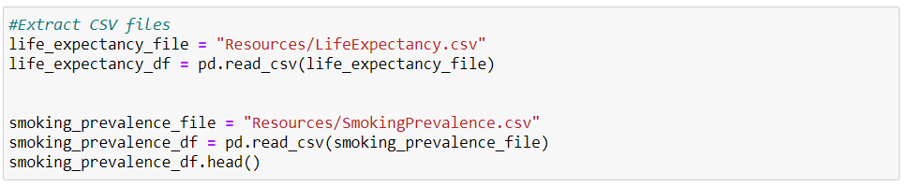
E T L
Extracted CSVs in jupyter notebook with a pandas dataframe

Slide 3
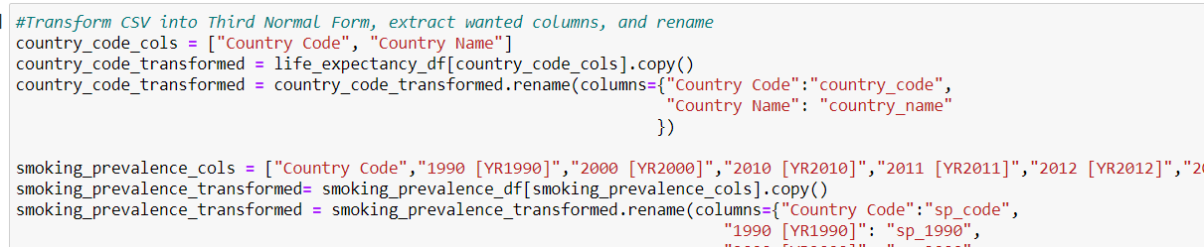
E T L
Put data into Third Normal Form, with separate country code and country name table.
Pulled only the columns wanted into a transformed data frame.
Cleaned the data to replace the blank cells “..” with “NaN”

Slide 4
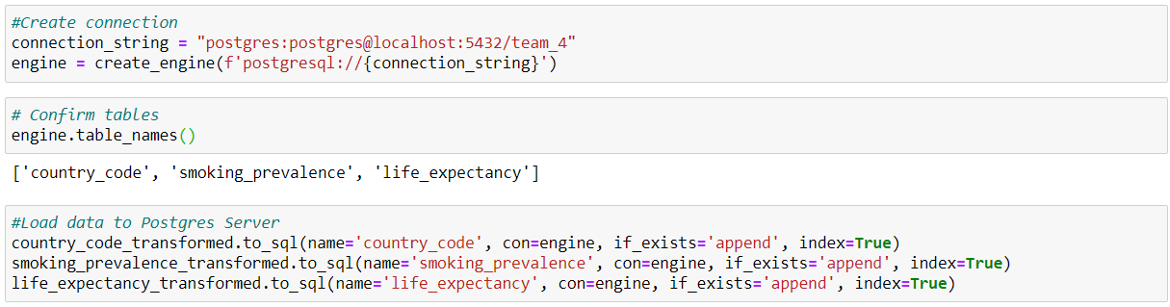
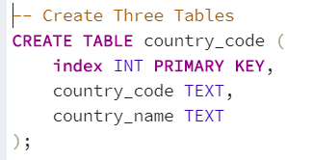
E T L
Schema create to initialize tables with Primary Key values.
Connection to Postgres server established in jupyter notebook.
Dataframes loaded into Postgres server.

Slide 5
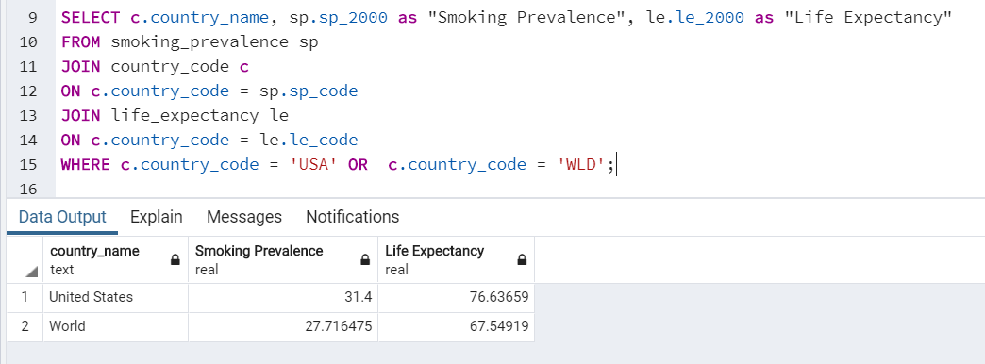
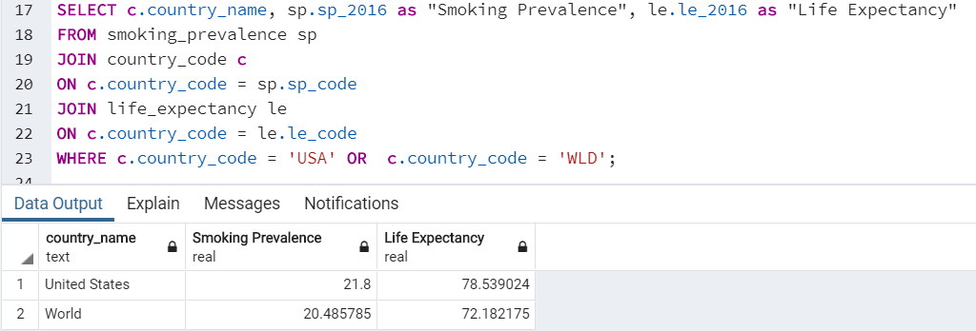
E T L
Two tables pulled using join

